Slide 1


PHYSIONET 2012 · ICU MORTALITY
A method for studying time sequences of clinical indicators of intensive care patients using Shapley values
NATIONAL RESEARCH
TOMSK STATE
UNIVERSITY
Faculty of Applied Mathematics
& Computer Science
A Time-Step SHAP Attribution Approach
on the PhysioNet 2012 Challenge Cohort
MASTER'S THESIS DEFENCE
01.04.02 · Applied Mathematics
and Computer Science
Master Degree :Data Science
PRESENTED BY
Ihsan Naqvi
SUPERVISOR
Tomsk · 2026
Associate Professor Sergey Axynov

Slide 2
Relevance & Motivation
U
TOMSK · 1878
An intensive-care-unit (ICU) model must both predict mortality and defend that prediction on clinical rounds
.
The Acute Physiology and Chronic Health Evaluation (APACHE) system, introduced by Knaus and colleagues.
Simplified Acute Physiology Score (SAPS), developed in parallel by Le Gall and colleagues in France.
01
02
03
13–20%
1981
0.74
of inpatient hospital costs
APACHE I → still in use
AUROC, no reason given
ICU is critical & costly
Severity scores are dated
Deep models are opaque
ICUs consume up to 20% of hospital budgets while caring for under 10% of admissions. A delayed escalation or missed septic shock carries irreversible cost.
Introduced in 1981, APACHE is still used today (as APACHE II/III/IV) — a 40-year-old methodology. Like SAPS-I, it collapses 24 h into one worst-value vector and treats missingness as random.
Deep nets often match clinicians on metrics but cannot defend a prediction. Trust is the bottleneck for bedside adoption — not accuracy.
02

Slide 3
Problem · Hypothesis · Scope
U
TOMSK · 1878
PROBLEM
What we set out to solve
Build a model on PhysioNet 2012 Set-A that (a) outperforms classical severity scores AND (b) explains every prediction on the (hour × variable) axis a clinician already uses to reason about patients.
HYPOTHESIS
What we expect to find
If we encode WHEN a measurement was taken — adding missingness as a parallel channel — and REDISTRIBUTE Shapley values onto the tempo SAPS-Iral axis, the resulting attributions will agree with established clinical severity scores (SOFA,).
SCOPE
What we cover
PhysioNet 2012 Challenge · Set-A · 4,000 adult ICU patients · first 48 hours after admission · 37 physiological + 6 descriptor variables · in-hospital mortality (13.9% positive rate).
03

Slide 4
Object · Subject · Aim · Tasks
U
TOMSK · 1878
OBJECT
RESEARCH TASKS
In-hospital mortality prediction for adult ICU patients during the first 48 hours of admission.
1
Build a (4000 × 48 × 37) tensor with explicit missingness encoding.
SUBJECT
2
Train and compare XGBoost, TCN, and Time-Aware Transformer under identical protocol.
Time-resolved Shapley-value attribution that maps model evidence onto the (hour × variable) axis and agrees with established clinical severity scores.
3
Derive a time-step SHAP procedure returning attributions on the (hour × variable) axis.
AIM
4
Validate attributions against SOFA / SAPS-I and run a four-variant ablation study.
Develop, evaluate, and clinically validate an explainable deep-learning predictor that matches tree-ensemble discrimination while restoring temporal interpretability.
04

Slide 5
Dataset — PhysioNet / CinC Challenge 2012
TOMSK · 187
12,000
4,000
48 h
42
13.9%
Total ICU records
Labelled Set-A used
Observation window
Variables (6+37)
Mortality rate
GENERAL (6)
TIME-SERIES VARIABLES — 37 variables · all used as model input · plus 37 missingness mask channels
OUTCOME (5)
RecordID
VITAL SIGNS
RESPIRATORY
RENAL / METABOLIC
HAEMATOLOGY / LIVER
RecordID
UniqueID
HR
SaO2
BUN
HCT
Patient identifier
Heart rate
O₂ saturation Hb
Blood urea nitrogen
Haematocrit
Age
MAP
O2Sat
Creatinine
WBC
SAPS-I
Mean art. pressure
Pulse ox O₂ sat
Serum creatinine
White blood cells
Years
NISysABP
FiO2
Glucose
Platelets
Severity score
NI systolic ABP
Fractional O₂
Serum glucose
Platelets
Gender
SysABP
PaO2
HCO3
Albumin
SOFA
Inv. systolic ABP
Arterial O₂ press.
Serum bicarbonate
Albumin
0=F 1=M
DiasABP
PaCO2
Lactate
Bilirubin
Organ failure score
Lactate
Bilirubin
Height
Inv. diastolic ABP
Arterial CO₂ press.
Urine
ALP
Length of stay
NIDiasABP
pH
Urine output
Alkaline phosphatase
Days in hospital
cm
NI diastolic ABP
Arterial pH
K
ALT
NIMAP
MechVent
Serum potassium
Alanine transaminase
Survival
Weight
NI mean ABP
Mech. ventilation
Na
AST
kg
RespRate
Serum sodium
Aspartate transaminase
Days alive
Respiratory rate
Mg
TropI
ICUType
Temp
Serum magnesium
Troponin-I
★ In-hospital death
Temperature
Chloride
TropT
CCU/CSRU/MICU/SICU
GCS
Serum chloride
Troponin-T
TARGET 0=survived
1=died
Glasgow Coma Scale
Calcium
Weight
Serum calcium
Weight (time-series)
Training / Validation / Test = 2,800 / 600 / 600
05

Slide 6
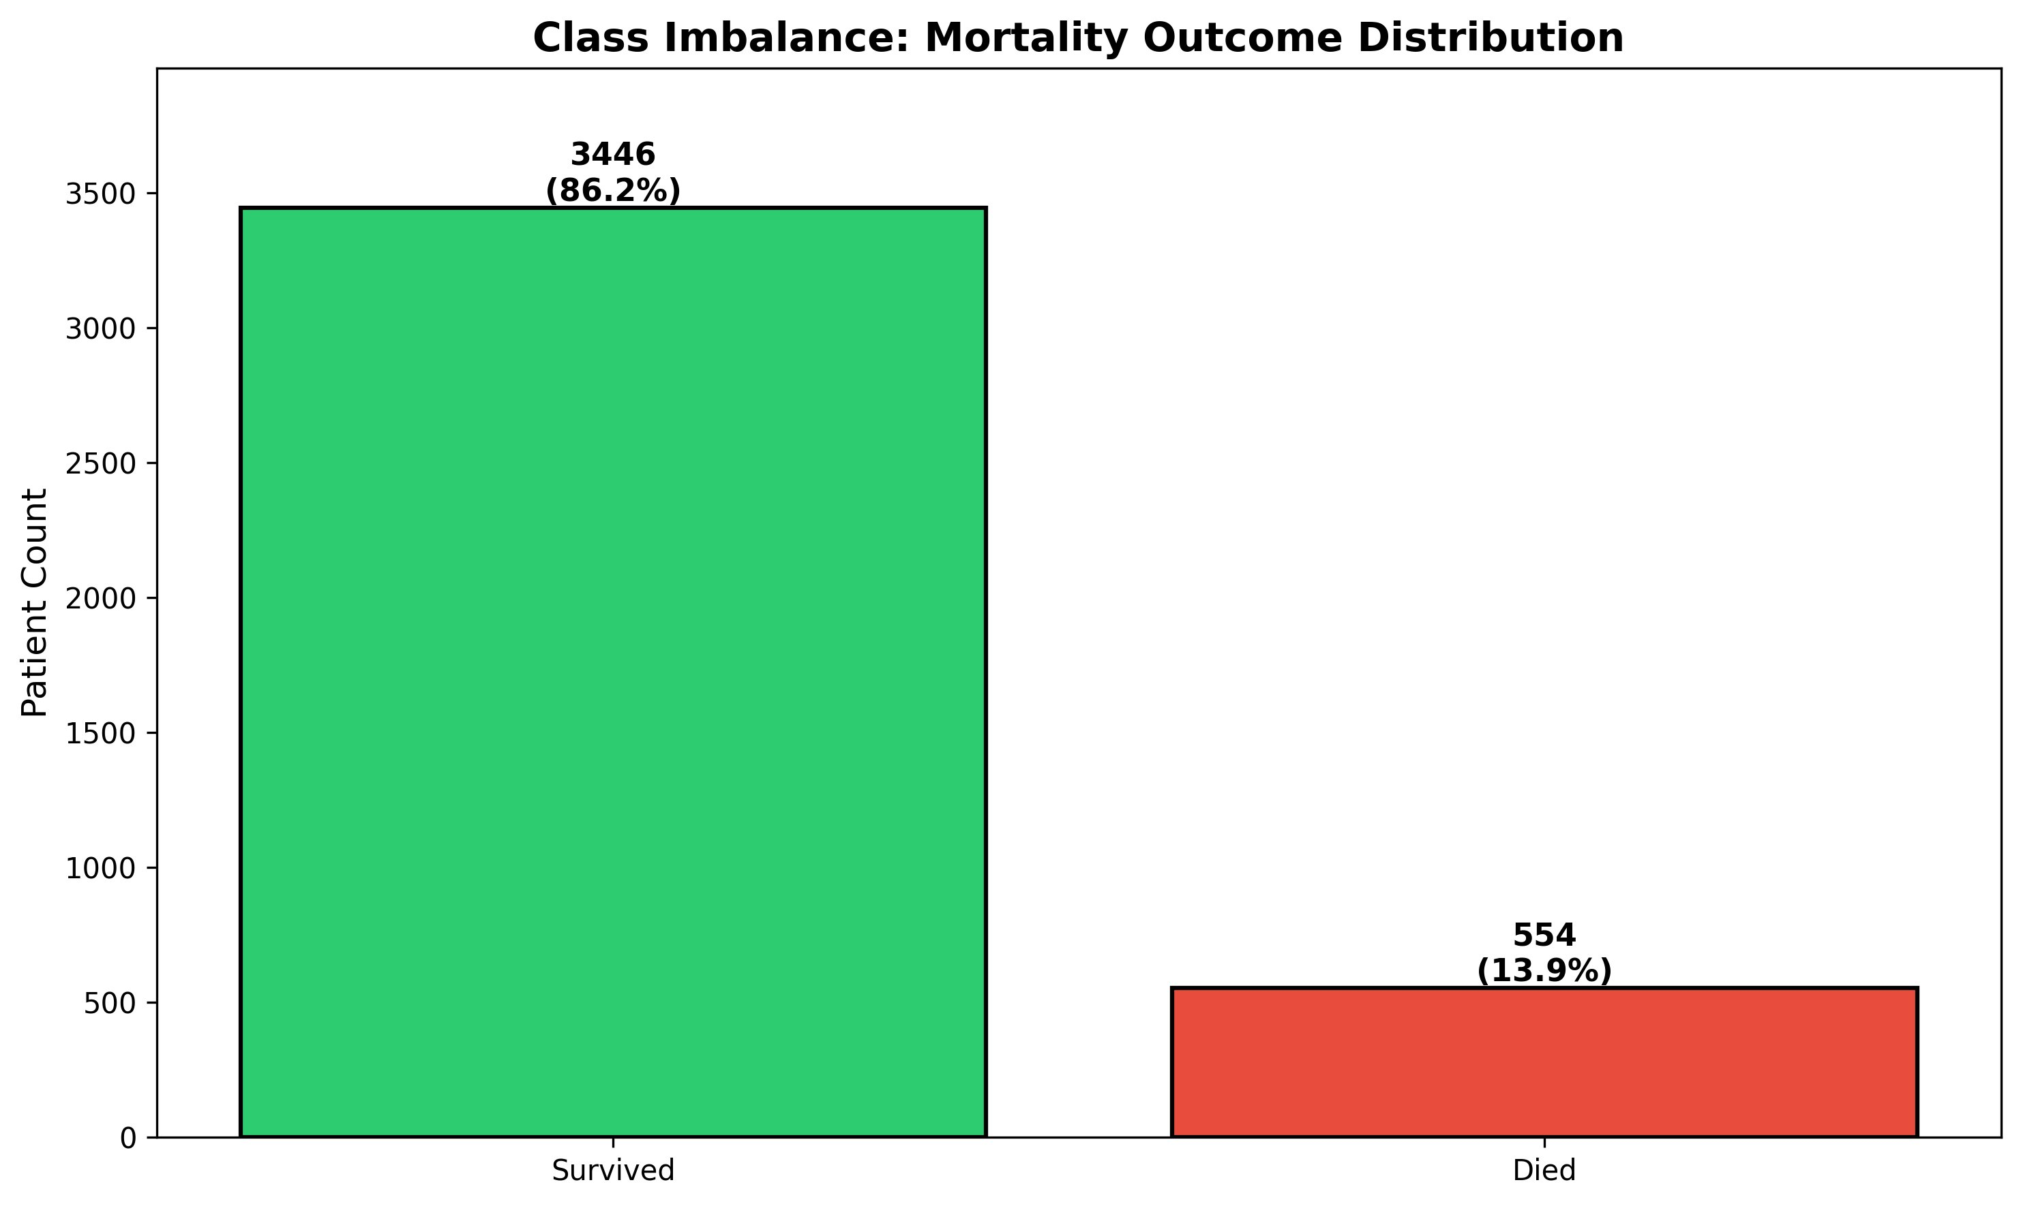
Dataset Composition — Real Cohort
TOMSK · 1878
4,000
100%
Total Set-A cohort
3,446
86.2%
Survivors
554
13.9%
In-hospital deaths
★ CHALLENGE
6.2 : 1
Figure 1. Class Imbalance: Mortality outcome distribution
survivor-to-death ratio
06

Slide 7
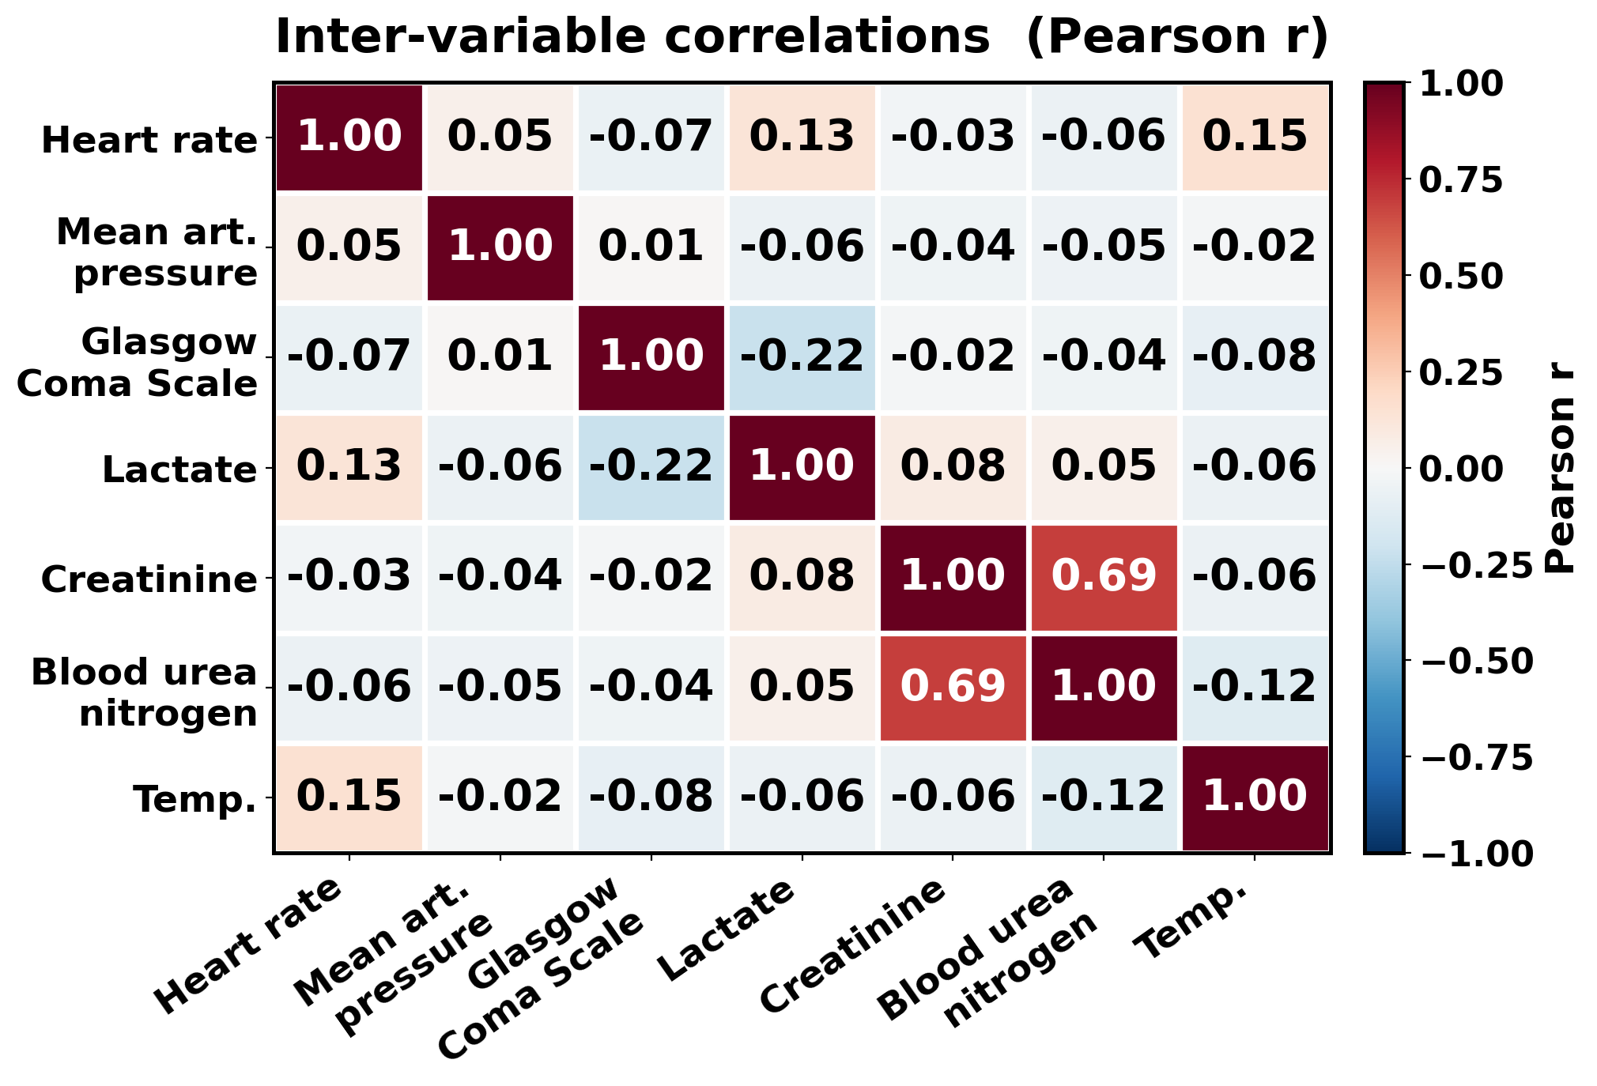
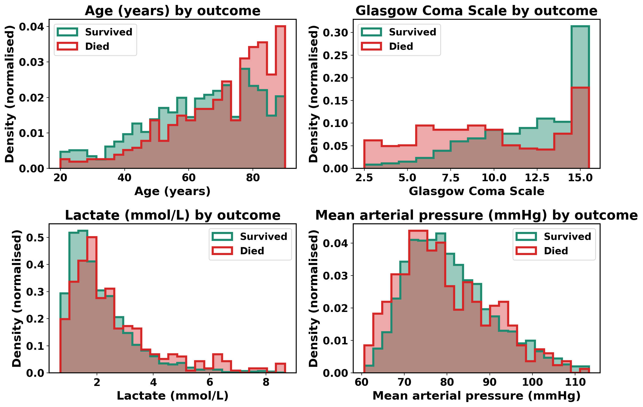
Exploratory Analysis — Key Predictors
U
Figure 3. Inter-variable correlations.
KEY FINDING
GCS, Age, Lactate, MAP
clearly separate outcomes
Figure 2. Distribution of four key predictors by outcome.
07

Slide 8
Key Formulas — Time-Step SHAP, Concordance, Focal Loss
U
Φ(h, v) = Φᵥ · |X[h, v]| / Σₕ |X[h, v]|
where Φᵥ = the variable's overall Shapley value (its global importance); X[h, v] = the value of variable v at hour h; the denominator sums |X| over all 48 hours (h = 0…48).
Time-step SHAP splits each variable's Shapley value Φᵥ across the 48 hours in proportion to its signal magnitude, so attribution is resolved in time while the per-variable total is preserved.
Worked example: if Glasgow Coma Scale has Φᵥ = 0.99 and hour 0 holds 4% of its |X| over the 48 hours, then hour 0 receives 0.04 × 0.99 = 0.040; summing all 48 hourly shares returns the original 0.99.
C(p) = |Top₅(p) ∩ S| / 5 , ρ = Spearman(−C, Brier) = +0.139
where Top₅(p) = patient p's five most-attributed variables; S = the variables used by the SOFA / SAPS-I clinical scores; Brier = the prediction's calibration error; ρ = rank correlation across all patients.
Clinical concordance: the share of a patient's five most-attributed variables that belong to the clinical score set S. Higher concordance goes with better calibration (p < 0.001).
FL(pₜ) = −α (1 − pₜ)^γ · log(pₜ)
where pₜ = the predicted probability of the true class; γ = 2 sets the focusing strength; α = 0.86 weights the rare death class.
Focal loss (deep models): (1 − pₜ)^γ with γ = 2 down-weights easy cases and α = 0.86 rebalances classes, so training concentrates on the rare deaths.
08

Slide 9
Method — Four-Stage Pipeline
U
1
Preprocessing
2
Modelling
3
Time-step SHAP
4
Clinical validation
Hourly median aggregation
XGBoost (227 features)
TreeSHAP on flat features
SOFA / SAPS-I concordance
▸
▸
▸
Missingness mask channel
TCN (dilations 1·2·4·8)
Redistribute Φ over 48 h
Spearman ρ vs calibration
70/15/15 stratified split
Time-Aware Transformer
Weighted by | X[h,v] |
4-variant ablation
NOVELTY IN THE PIPELINE
★ Time-Aware Transformer
★ Time-Step SHAP Redistribution
Missingness-aware (48 × 74) input · learnable sinusoidal positional encoding · CLS-token classification head · focal loss for imbalanced cohort. Designed for irregularly-sampled critical-care data.
TreeSHAP gives one Φ per flat feature → temporal axis is lost. We sum Φ across the 5 stats per variable, then redistribute over 48 hours weighted by | X[h, v] |. Conservation and locality preserved.
09

Slide 10
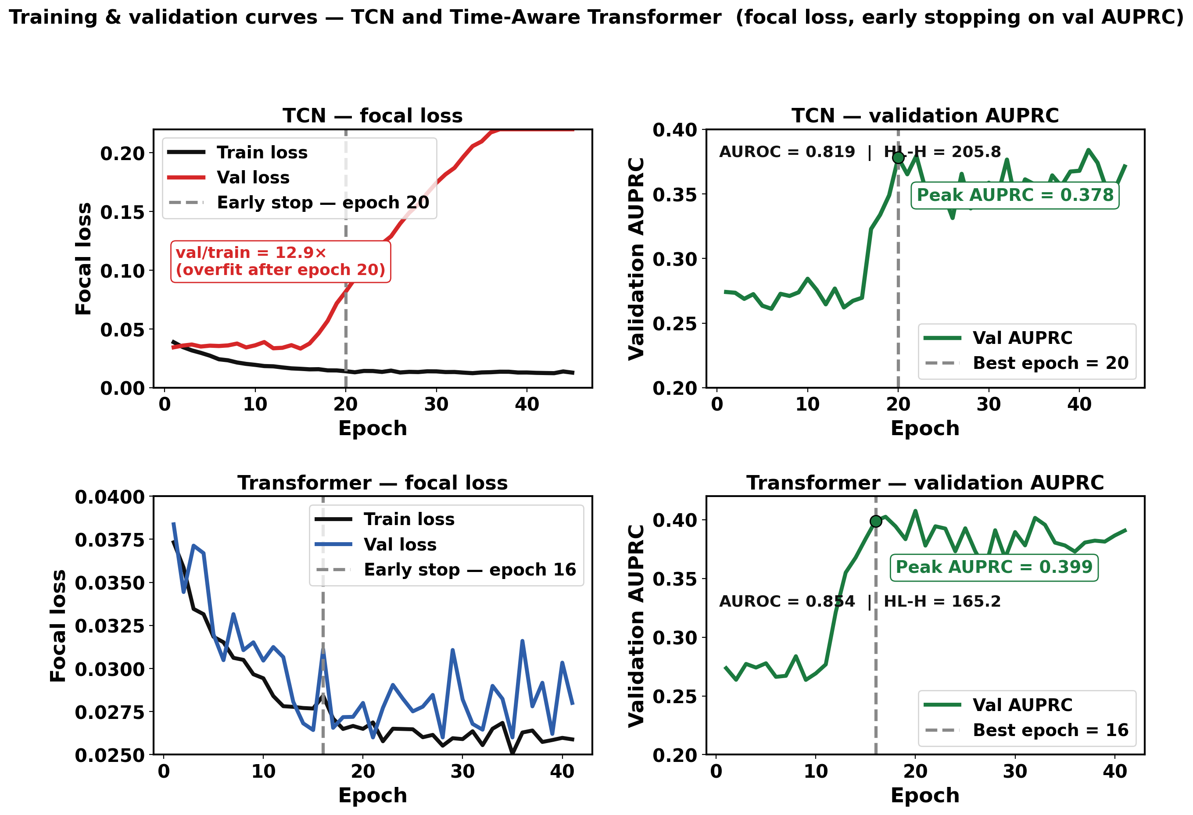
Training Convergence — Both Deep Models
U
Training and validation curves – TCN and Time Aware Transformer(focal loss, Early stopping on val AUPRC
TRAINING PROTOCOL
Optimizer
Adam (lr 3e-4)
Loss
Focal γ=2 α=0.861
Batch size
64
Early stopping
Val AUPRC
Train / Val / Test
2800 / 600 / 600
TCN params
162 K
Transformer
205 K · 4 heads
Hardware
NVIDIA GPU
Both deep models converge cleanly before overfit; early stopping triggers.
10

Slide 11
How Model Performance Is Measured/Evaluation Metrics and Their Formulas
U
TP = deaths correctly flagged · FP = false alarms · FN = missed deaths · TN = survivors correctly cleared
Precision = TP / (TP + FP)
Of the patients flagged as high-risk, the share who truly died (positive predictive value).
Recall (Sensitivity) = TP / (TP + FN)
Of the patients who truly died, the share the model caught (a missed death is the costly error).
F1 = 2·Precision·Recall / (Precision + Recall) Score₁ = min(Recall, Precision)
F1 is their harmonic mean; Score₁ (PhysioNet 2012 official metric) is high only when BOTH precision and recall are high.
AUROC = area under ROC curve AUPRC = area under precision–recall curve
AUROC = chance a random death is ranked above a random survivor (threshold-free); AUPRC is more informative under heavy imbalance (13.9% deaths).
Illustrative: a model with Recall = 0.80 but Precision = 0.30 still scores Score₁ = min(0.80, 0.30) = 0.30 — it cannot hide weak precision behind high recall.
On the 600-patient test set (83 deaths), the best model (XGBoost) reached Score₁ = 0.542, AUROC = 0.880, AUPRC = 0.538.
11

Slide 12
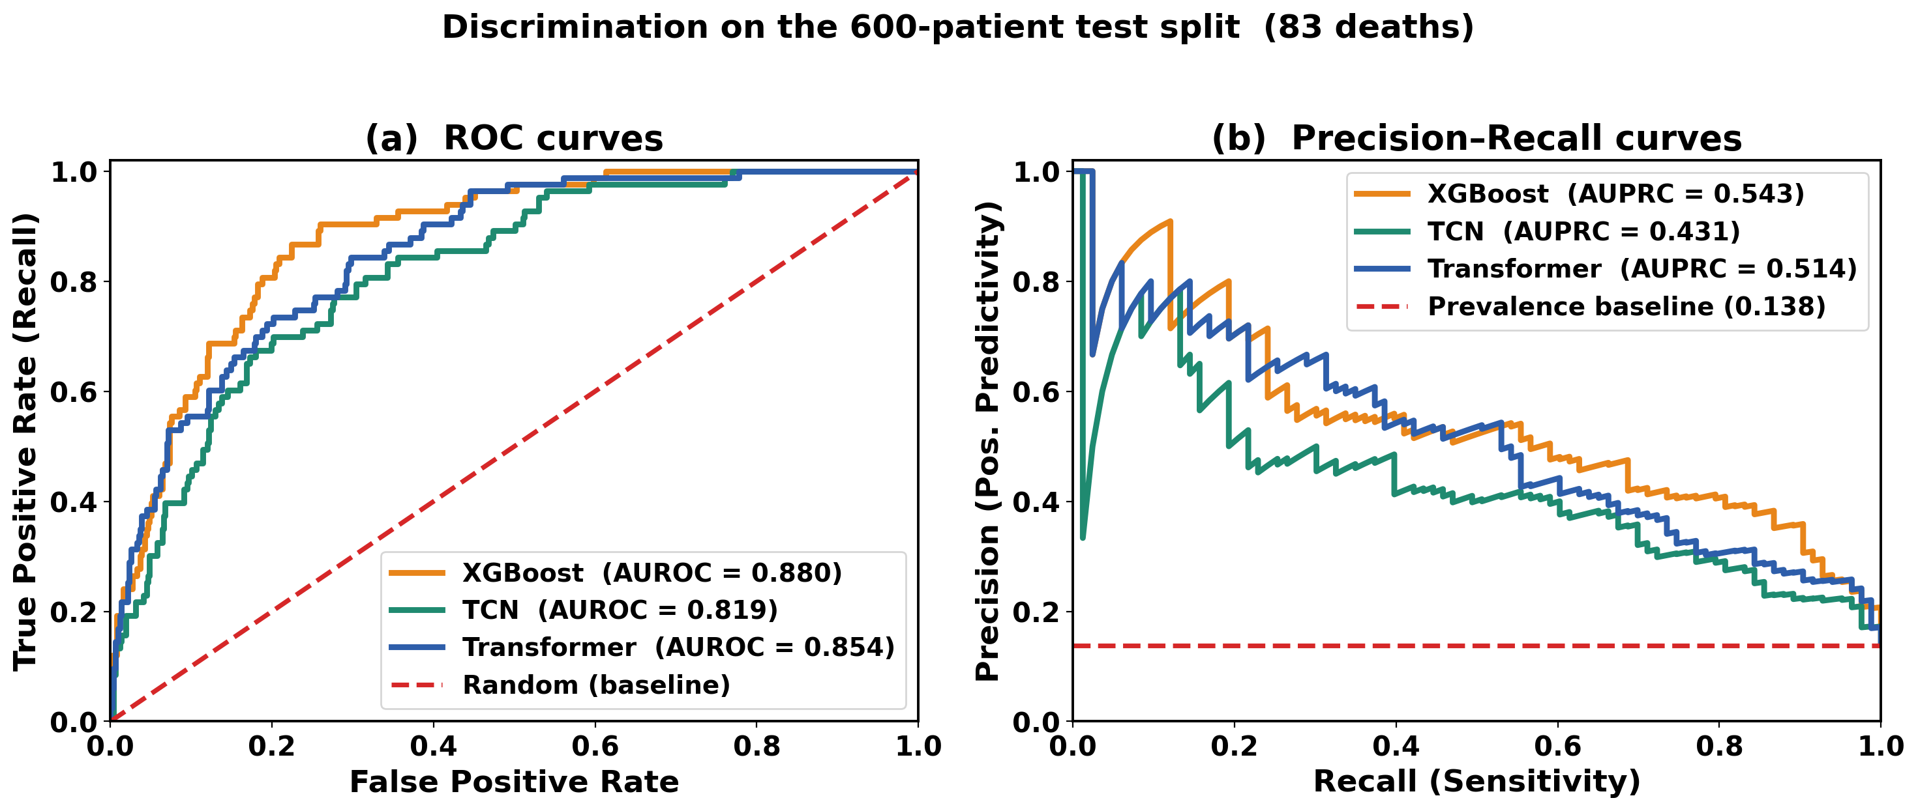
Final Results — Model Comparison
U
★ BEST OVERALL
Figure 6. Final comparison on 600-patient held-out test set.
12

Slide 13
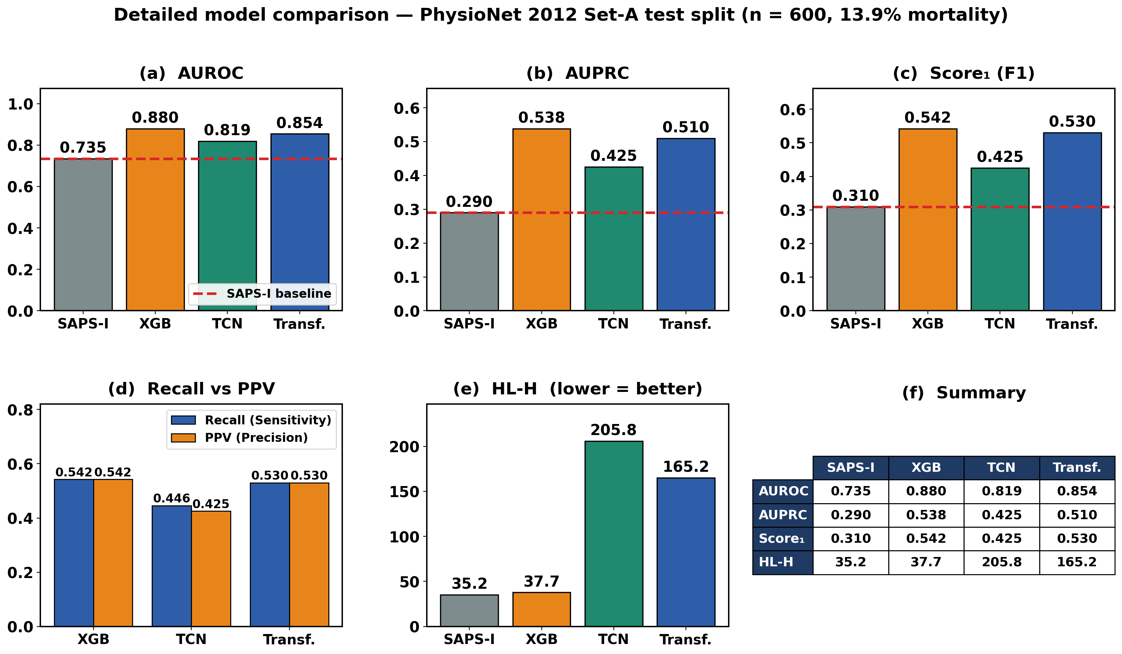
Final Results — Model Comparison
U
★ BEST OVERALL
XGBoost
AUROC 0.880 · Score₁ 0.5422
vs. SAPS-I baseline
+75%
absolute gain on Score₁
0.3097 → 0.5422
CALIBRATION TRADE-OFF
Deep models (HL-H 165, 206)
sacrifice calibration for
discrimination — see Slide 12.
Score₁ = min(Recall, Precision) = min(Sensitivity, Positive Predictivity)
13

Slide 14
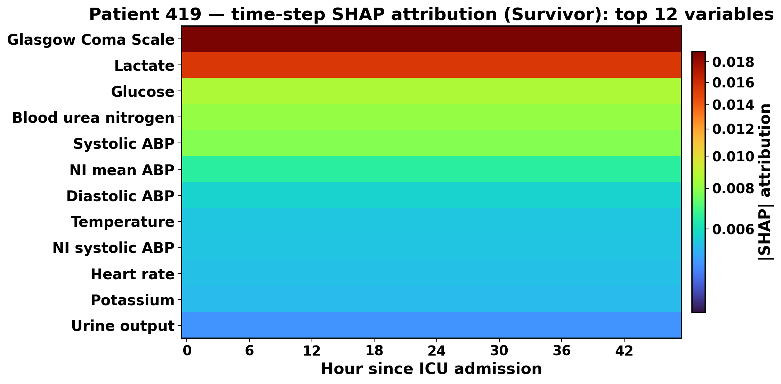
Time-Step SHAP in Action — Patient 419
U
WHAT TO READ FROM THIS HEATMAP
RED
GCS dominates the attribution — model picked up the strongest clinical signal.
ORANGE
Lactate carries strong secondary evidence across the full window.
Glucose, BUN, NIMAP contribute moderate support to the prediction.
LIGHT Green
BLUE
The remaining labs (Heart rate, Potassium, Urine…) carry the least attribution — the model concentrates on a few strong signals.
Attribution lives in the
clinician's mental model.
Figure 7. Per-patient time-step SHAP heatmap — Patient 419 (Survivor).
14

Slide 15
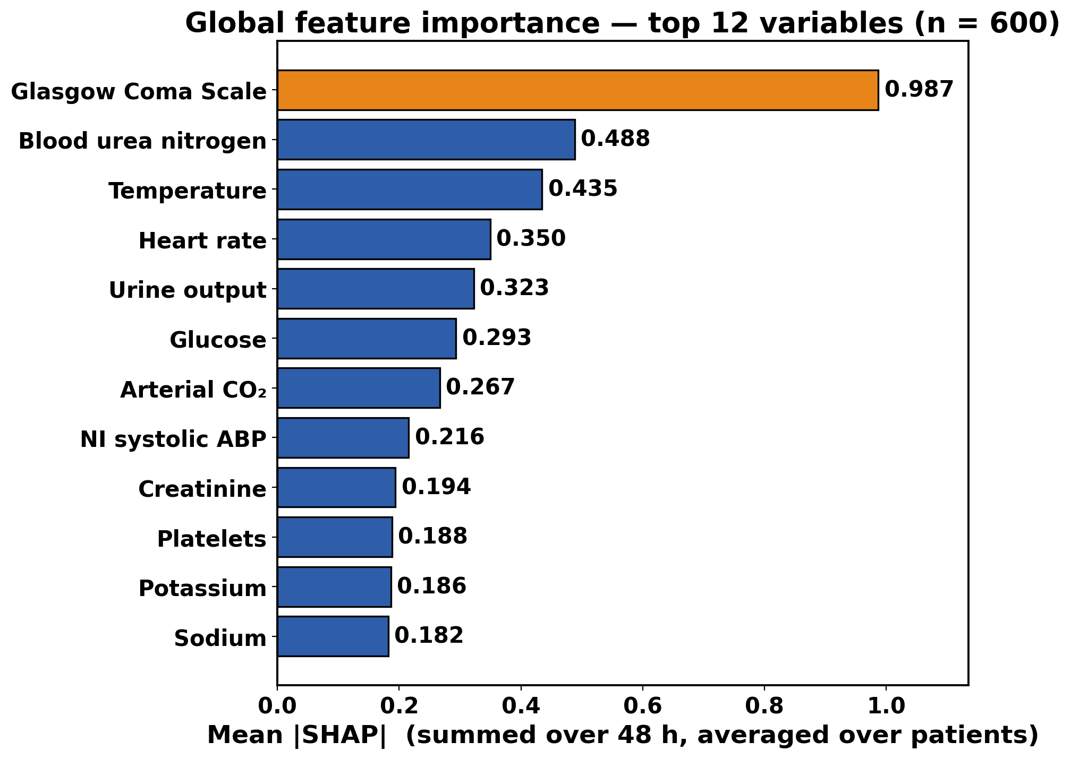
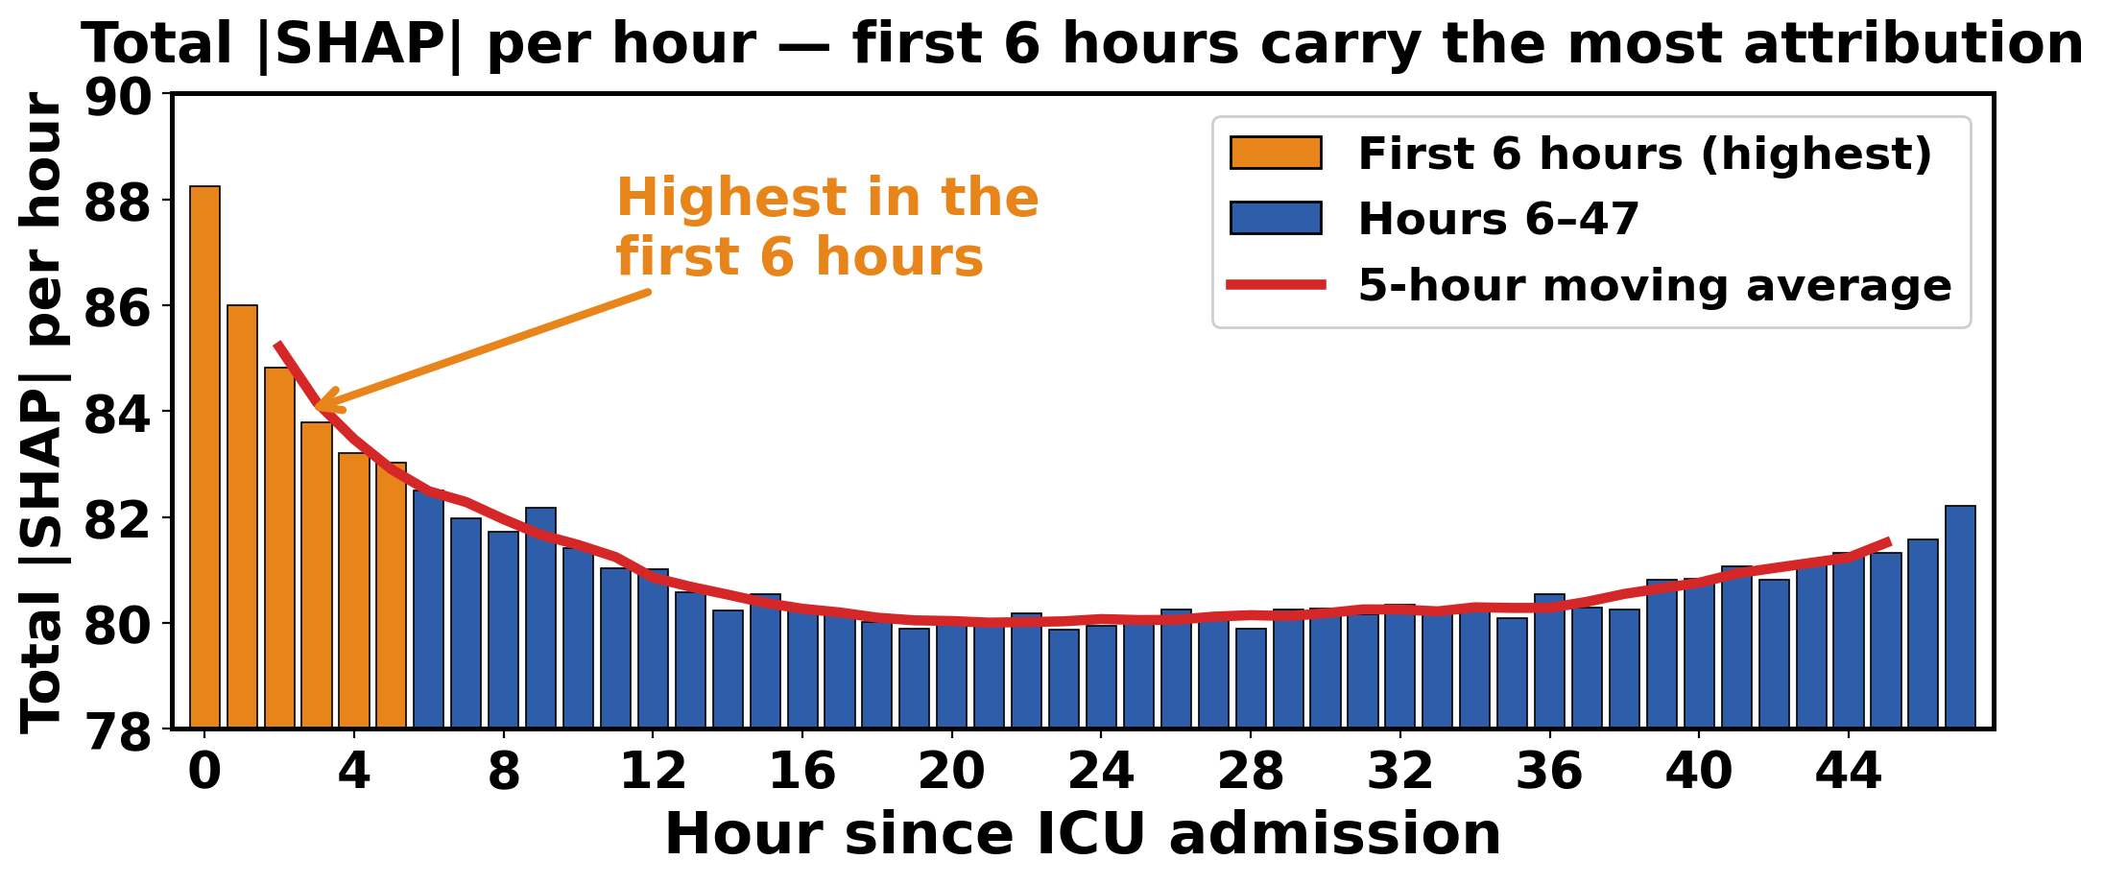
Cohort-Level SHAP — What Matters Globally
U
TOMSK · 187
Figure 9. Total |SHAP| per hour — which hours matter most.
KEY CLINICAL FINDINGS
by far the strongest predictor — 2× any other
★
GCS dominates
✓
Top-10 are clinical
all appear in SAPS / APACHE / SOFA scores
⌚
First hour matters
early measurements carry slightly more weight
Figure 8. Top variables by mean |SHAP| across 4,000 patients.
15

Slide 16
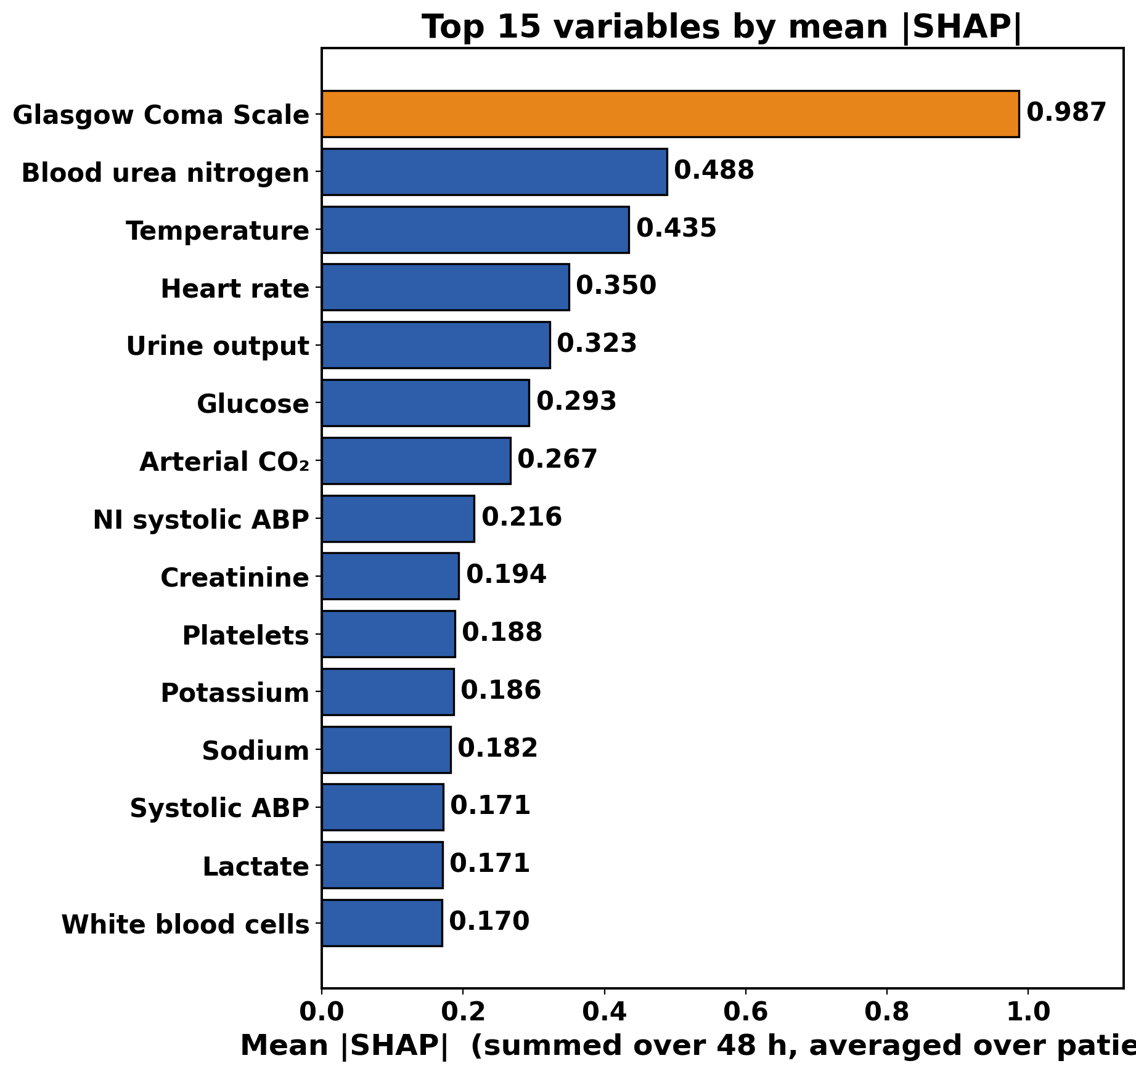
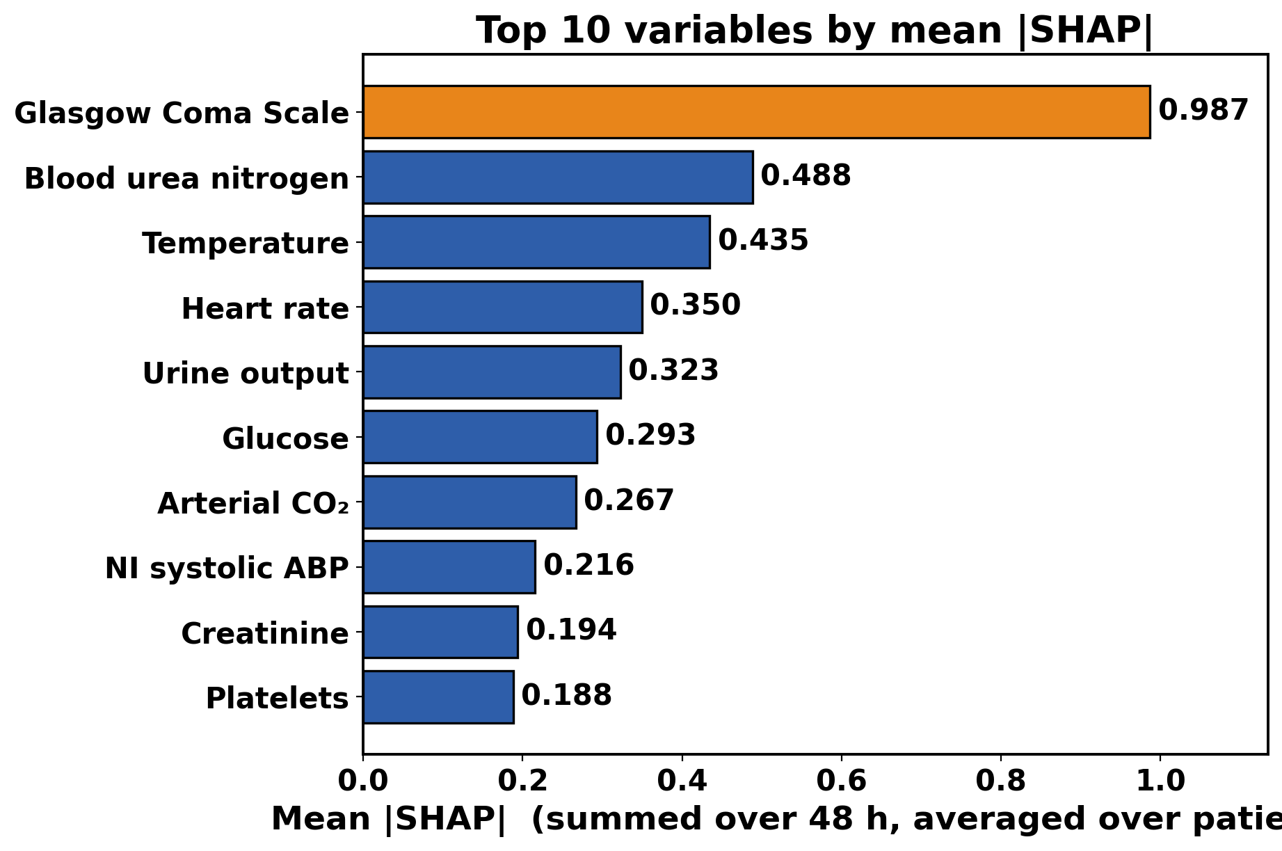
U
SHAP — Global Feature Importance
TOMSK · 187
Figure 10. Top 10 variables by mean |SHAP| across 4,000 patients.
Figure 11. Top 15 variables by mean |SHAP| across 600 test patients.
16

Slide 17
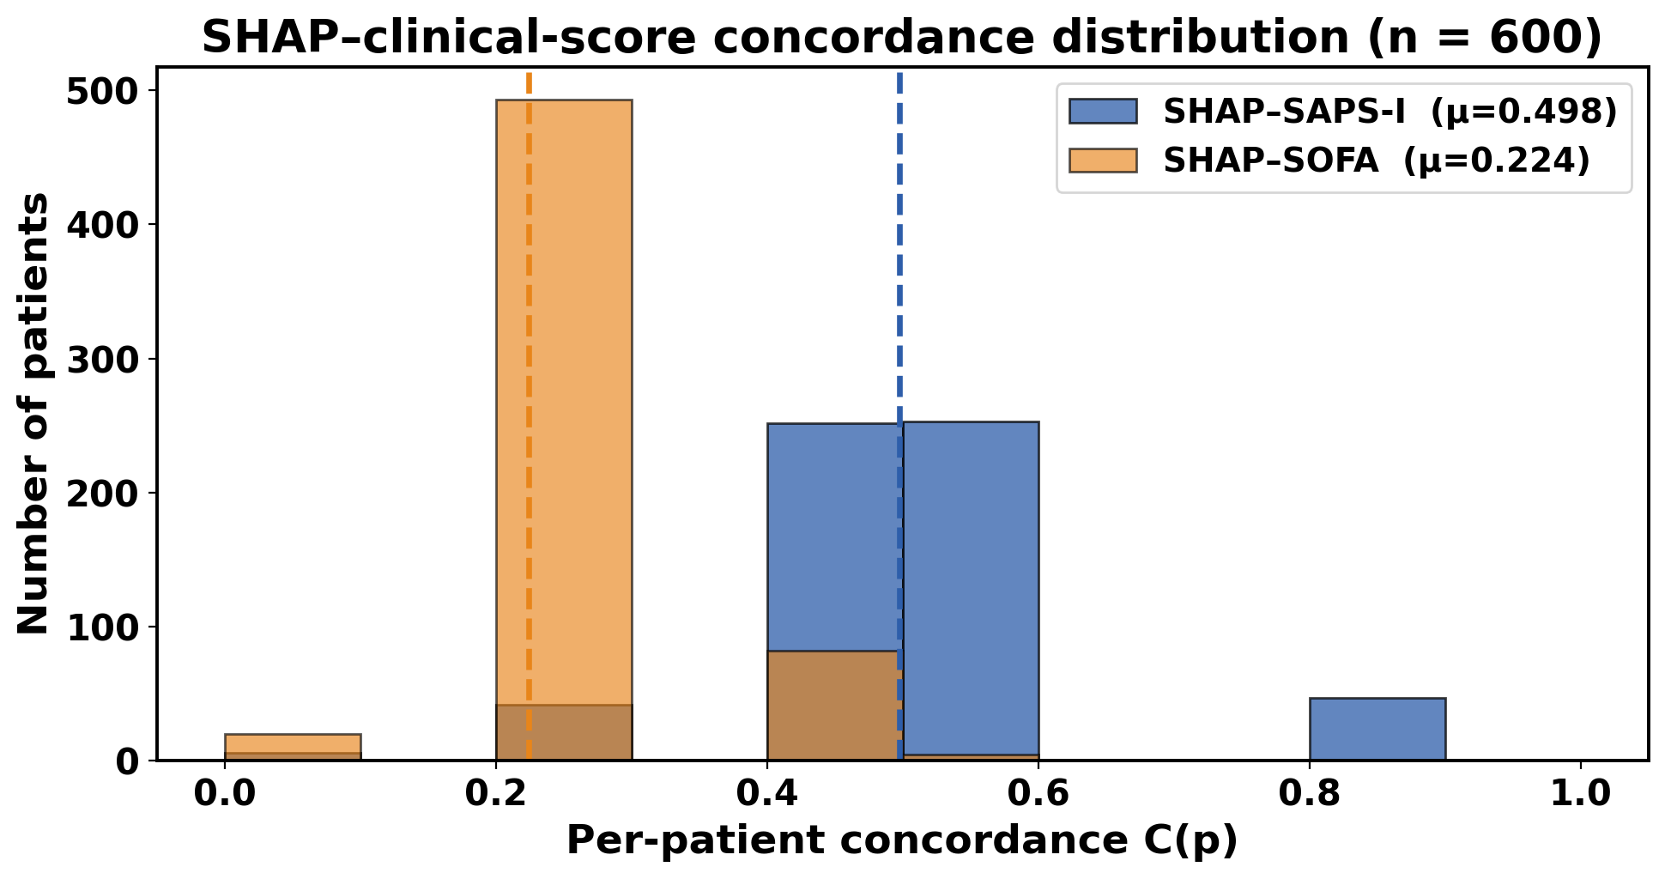
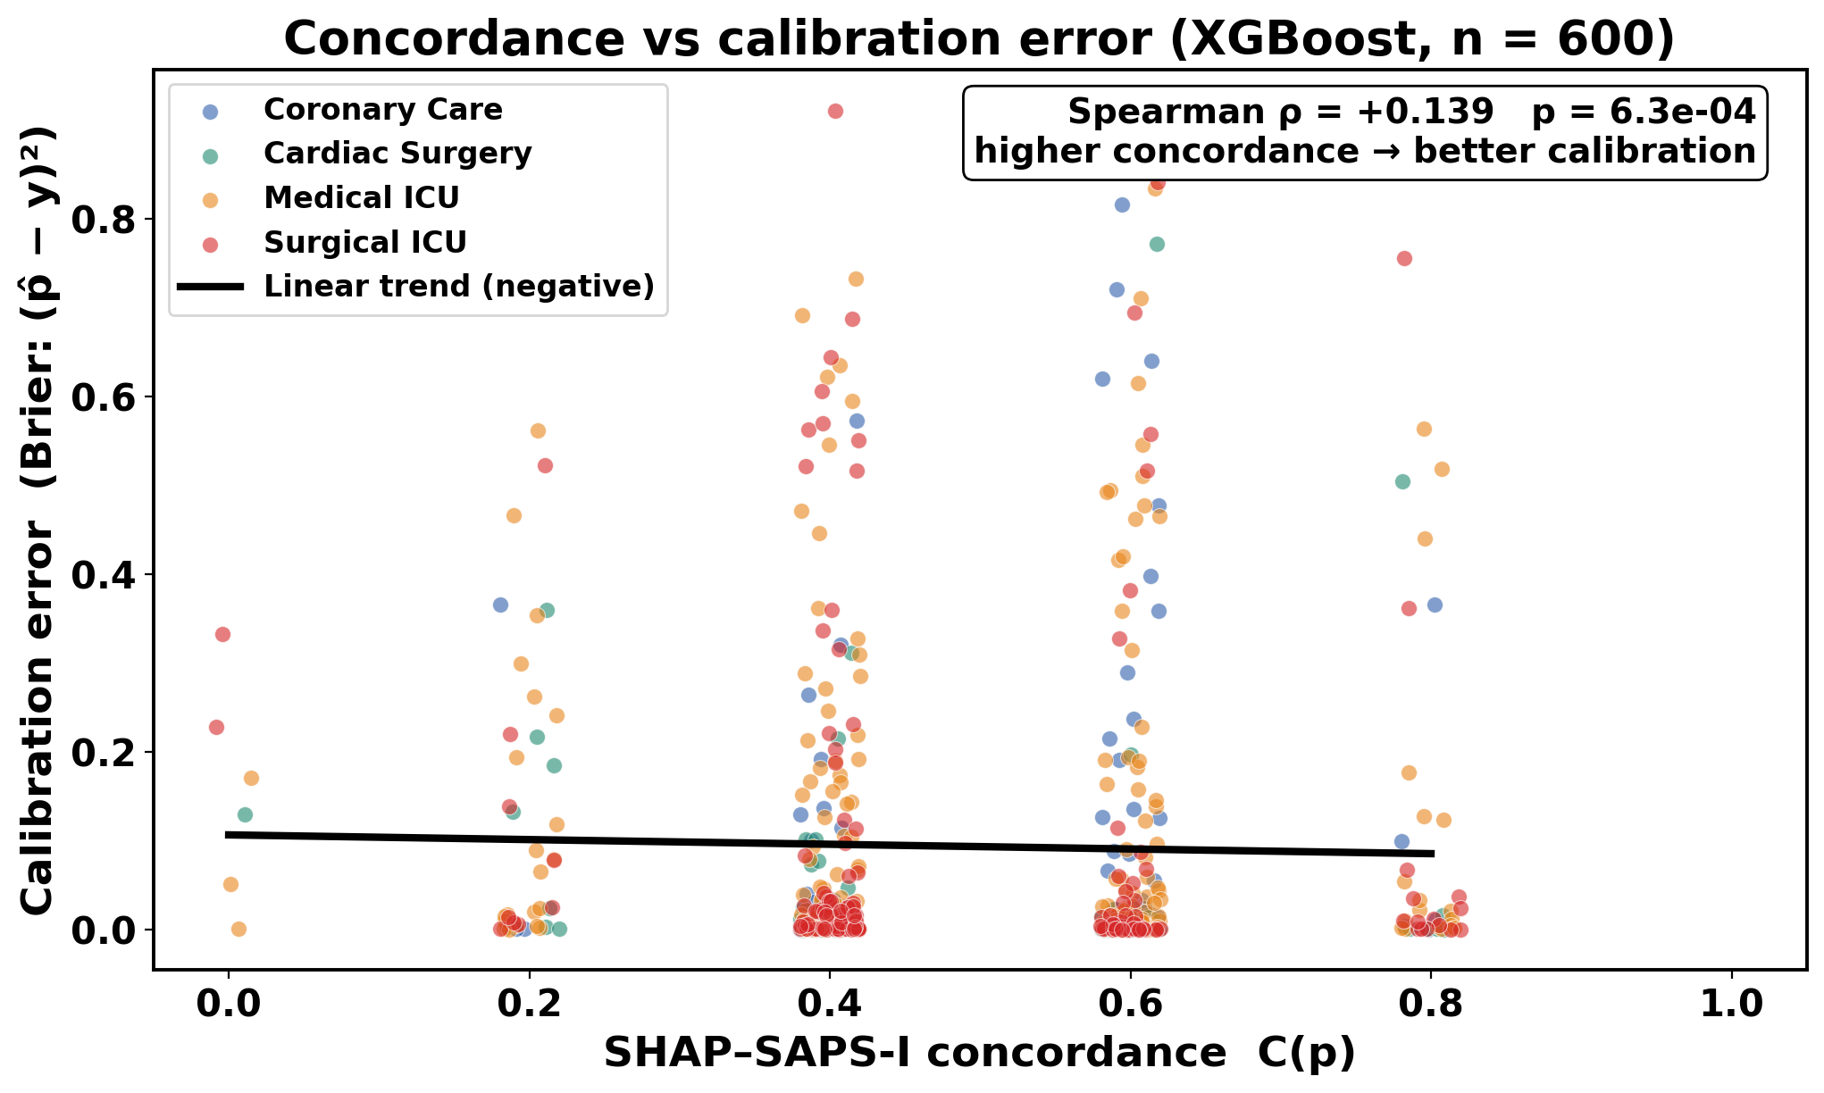
Clinical Validation — SHAP vs SOFA / SAPS-I
HEADLINE NUMBERS
SHAP–SAPS-I
0.498
mean concordance
3.7× above chance baseline
Figure 12. SHAP–SOFA (μ=0.224) and SHAP–SAPS-I (μ=0.498) concordance distributions.
SHAP–SOFA
0.224
mean concordance
weaker — SOFA includes vars
XGBoost does not weight highly
Attribution validated against
established clinical scoring.
Figure 13. Concordance vs calibration error — SAPS-I trend is negative (good).
17

Slide 18
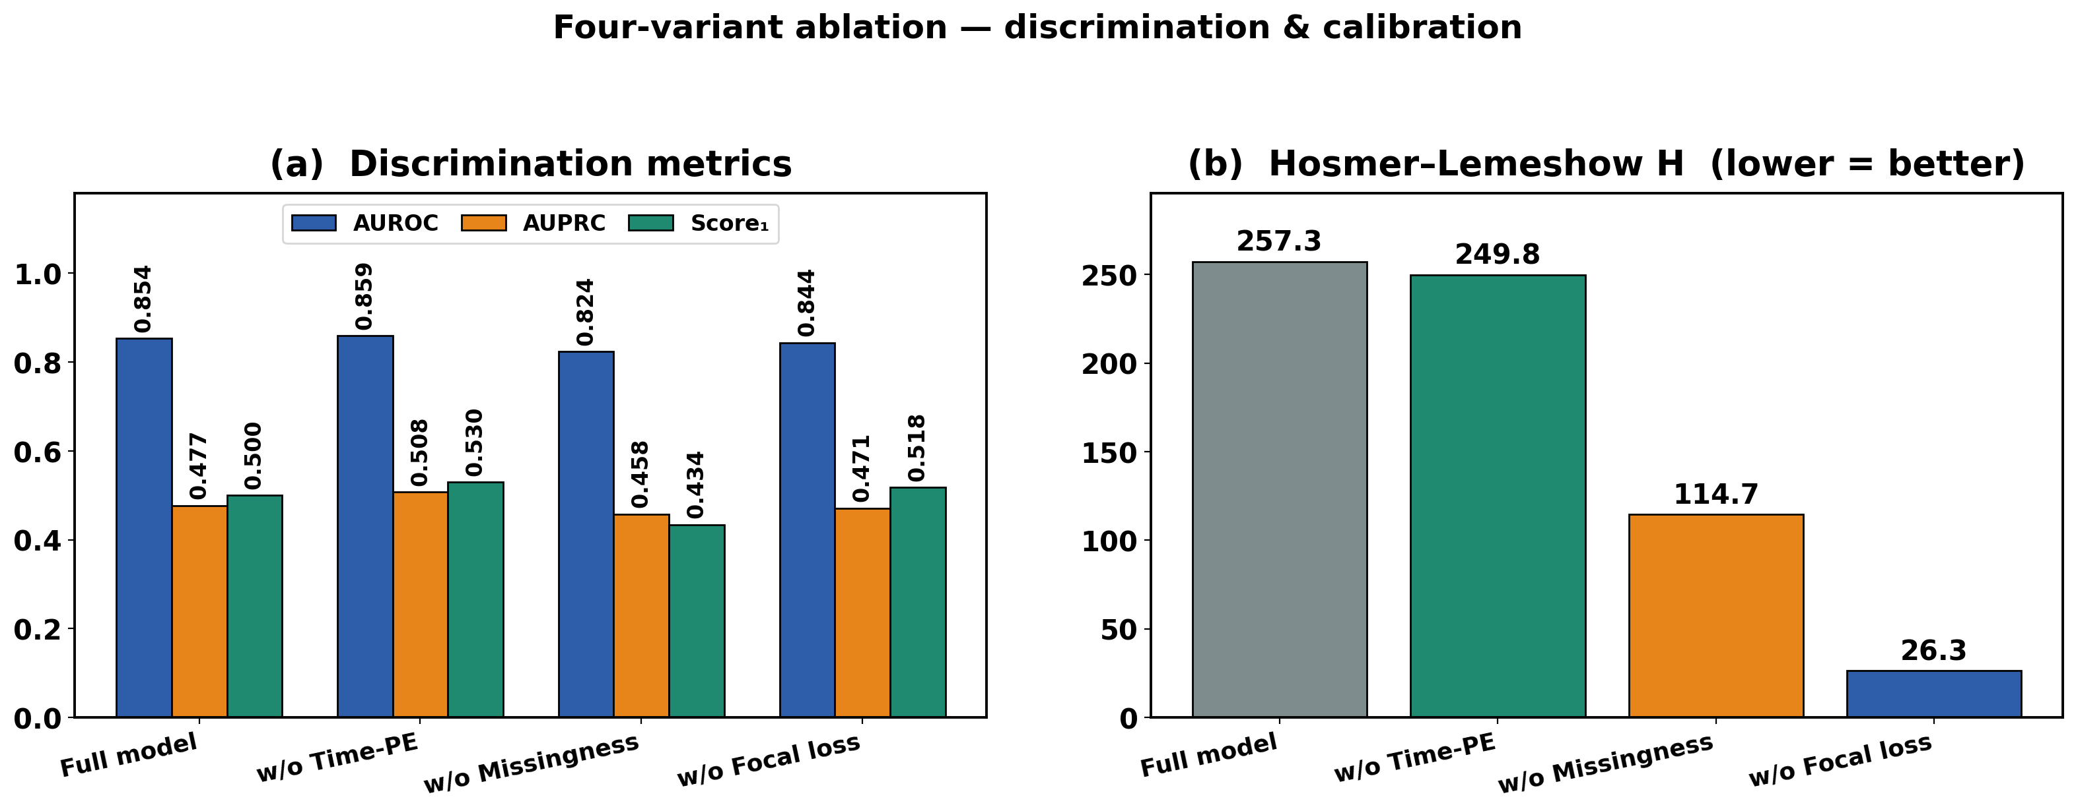
Ablation Study — Component Contribution
U
★ HEADLINE
−6.6 pp
Score₁ drop when removing
missingness encoding
KEY INSIGHT
Encoding WHEN a measurement was taken is the single most informative design choice in the entire pipeline.
Figure 14. Four-variant ablation — discrimination & calibration metrics.
Variant
AUROC
AUPRC
Score₁
HL-H
Full Model (proposed)
0.854
0.477
0.500
257.3
w/o Time-aware PE
0.859
0.508
0.530
249.8
w/o Missingness
0.824
0.458
0.434
114.7
w/o Focal Loss
0.844
0.471
0.518
26.3
18

Slide 19
Scientific Novelty — Three Pillars
U
I
II
III
Missingness-aware
Time-Aware Transformer
Time-Step SHAP
Redistribution
Statistical Clinical
Validation
Encodes missingness as a parallel input channel + learnable sinusoidal positional encoding suited to irregularly-sampled ICU data.
Novel algorithm returning attributions on the (hour × variable) axis without retraining, preserving Shapley conservation and locality.
Quantitative SHAP–SOFA / SHAP–SAPS-I concordance proves attributions agree with established clinical severity scoring.
Together: A predictor whose explanation is temporally resolved AND statistically validated.
19

Slide 20
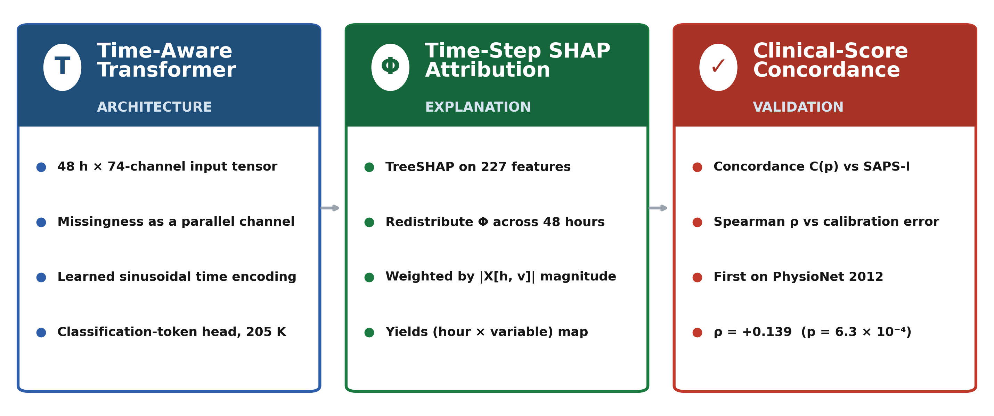
Scientific Novelty — Three Pillars
U
Together: A predictor whose explanation is temporally resolved AND statistically validated.
20

Slide 21
Conclusion
U
Research question answered: Can ML predict ICU mortality AND explain itself well enough for a clinician to trust it? — YES.
01
ML substantially outperforms clinical scoring
02
Consciousness level is the dominant mortality predictor
Score₁ 0.31 → 0.54 (+75%)
GCS mean |SHAP| = 0.99
XGBoost: AUROC 0.8798 · AUPRC 0.5384 · Score₁ 0.5422 on 600 unseen test patients. The 40-year-old SAPS-I baseline scored only 0.3097. Every ML model exceeded it.
GCS ranked #1 across all 4,000 patients — SHAP value nearly 2× the second-ranked variable (BUN = 0.50). The model independently rediscovered what clinicians already know.
03
Missing data encodes clinical decision-making
04
SHAP explanations are clinically validated
−6.6 pp Score₁ without missingness
SHAP–SAPS-I concordance = 0.498 (3.7× chance)
Removing the missingness channel caused the single largest drop in the ablation study. When a doctor does not order a test, that silence is itself a diagnostic signal — and the model learns it.
Time-step SHAP attribution statistically agrees with SAPS-I severity scoring. Explanations are not arbitrary — they match the physiological reasoning clinicians have trusted since 1984.
This research proves ICU mortality can be predicted AND explained — hour by hour, variable by variable, in the clinician's own coordinate system.
21

Slide 22


Reproducibility & Resources
Project repository (GitHub)
Dataset — PhysioNet 2012
github.com/ihsaanNaqvi/Explainable-ML-for-ICU-Mortality-Prediction
physionet.org/content/challenge-2012/1.0.0/
Both QR codes resolve in any phone camera. Repo contains code, models, result JSONs, and the full thesis. Dataset is free under the PhysioNet license.
22

Slide 23
THANK YOU
Questions are welcome.
Ihsan Naqvi
Tomsk State University · Tomsk · 2026

